Slide 1
inversion

Slide 2
在英语中，主语和谓语的语序通常的主语在前，谓语在后。
A disabled young man lies under the table .
The small boat went down.
A big supermarket lies the south of the lake.

Slide 3
注意：主语必须为名词的时候才可以完全倒装！
如果全部谓语在主语前,叫完全倒装;
如果只把助动词,系动词be或情态动词提前,就叫部分倒装.
地点副词要完全倒装
方位介词要完全倒装
完全倒装：
时间副词要完全倒装
表示运动的介词要完全倒装
作表语的形容词, 过去分词,现在分词要完全倒装

Slide 4
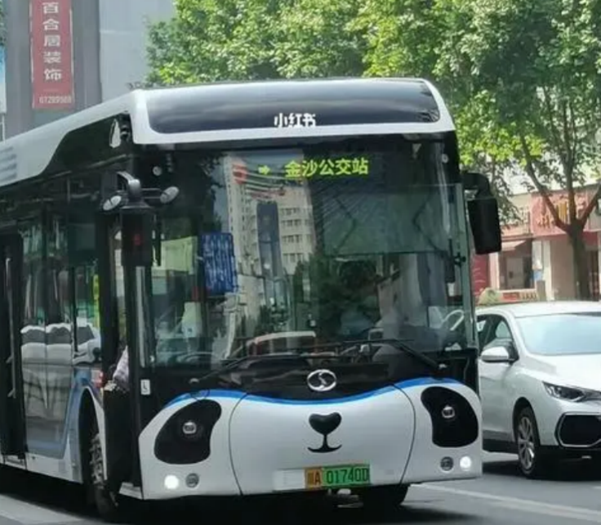
完全倒装句：
The bus comes here.
Here comes the bus.

Slide 5
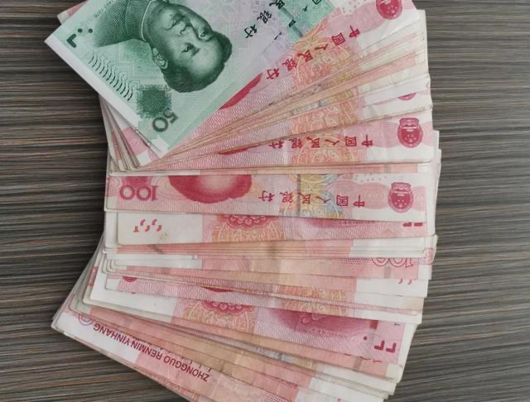
完全倒装句：
A lot of money was there.
There was a lot of money.

Slide 6

完全倒装句：
A woman stands here.
Here stands a woman.

Slide 7

完全倒装句：
A girl sat by the door.
By the door sat a girl.

Slide 8

完全倒装句：
This book is on the desk.
On the desk is this book.

Slide 9
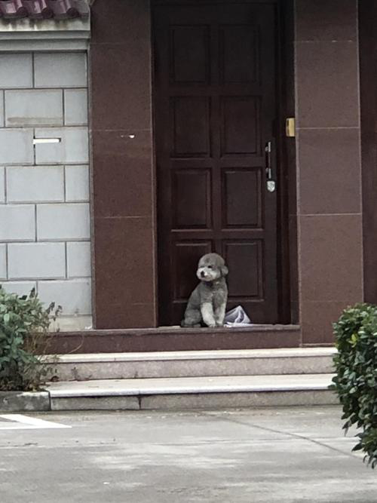
完全倒装句：
The little dog sit in front of the house.
In front of the house sit the little dog.

Slide 10
完全倒装句：
His house lies behind the mountain.
Behind the mountain lies his house.
Jack’s bag was left under the table.
Under the table was left Jack’s bag.

Slide 11
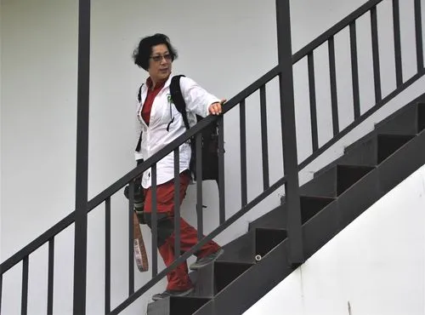
完全倒装句：
John came down.
Down came John.

Slide 12
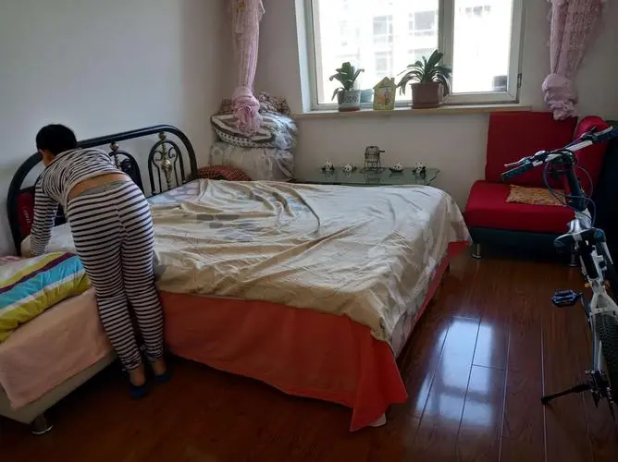
完全倒装句：
The woman walked in.
In walked the woman.

Slide 13
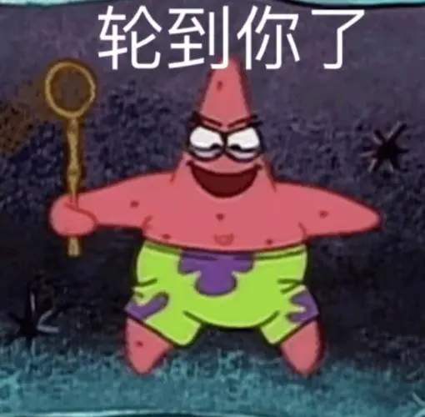
完全倒装句：
Your turn comes now!
Now comes your turn.

Slide 14
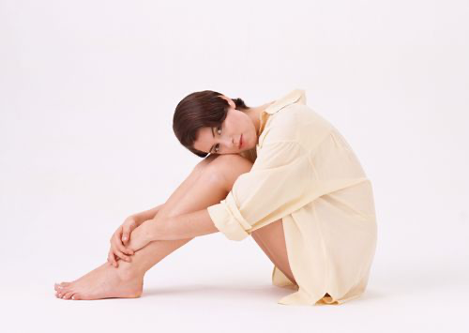
完全倒装句：
A lonely boy is sitting on the ground.
Sitting on the ground is a lonely boy.

Slide 15
The frightened tiger ran away.
A big mosquito came here !
Beijing is to the north of Nanjing.
Mike sat by the fire.
His elder sister was standing next to him.

Slide 16
有否定意义词要部分倒装(修饰名词时不用)
固定句型：neither/nor/so +be/情/助
有only要部分倒装
部分倒装：
有not until要部分倒装
有not only...but also要部分倒装
有as, though要部分倒装

Slide 17
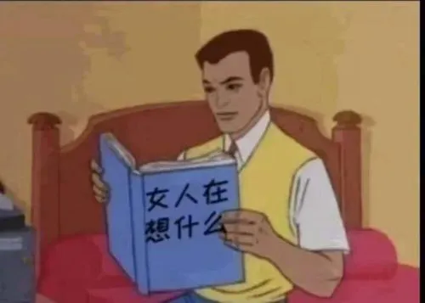
有否定意义词要部分倒装
I have never read such a good book.
Never have I read such a good book.

Slide 18
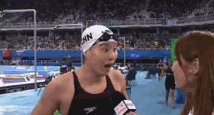
有否定意义词要部分倒装
She could hardly believe her eyes.
Hardly could she believe her eyes.

Slide 19
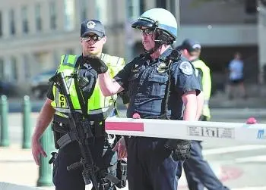
有否定意义词要部分倒装
He knew little that the police were around.
Little did he know that the police were around.

Slide 20
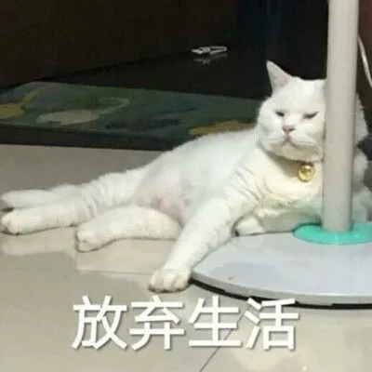
有否定意义词要部分倒装
I give up by no means.
By no means do I give up.

Slide 21
The western restaurant lies in the east of our school.
I never see such a beautiful place.
He was standing beside the West Lake.
I am willing to come to his party by no means.
The girls come down.

Slide 22

固定句型部分倒装：典型代表：So，Neither，Nor
I am very happy!
I will give up at once.
He wants to answer a call of nature.
我也是。So+ be/情/助+主语

Slide 23
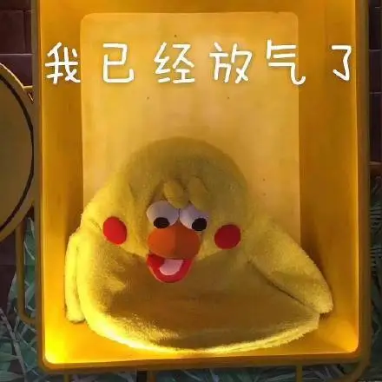
固定句型部分倒装：典型代表：So，Neither，Nor
I am very happy!
I will give up at once.
He wants to answer a call of nature.
我也不。Neither/nor+ be/情/助+主语

Slide 24
复习！！！！
地点副词：here，there
方位介词：on, by, in, under...
完全倒装：
时间副词: now...then...
表示运动方向的介词：in, down, up..
作表语的形容词, 过去分词,现在分词要完全倒装

Slide 25
A tree on the hill stands there .
Some tall buidings are around the lake.
The cat went away.
The rain came down and the umbrellas went up.
A new difficulty came then.
The deaf girl was standing next to the bus.

Slide 26
有否定意义词要部分倒装(修饰名词时不用)
固定句型：neither/nor/so +be/情/助
有only要部分倒装
部分倒装：
有not until要部分倒装
有not only...but also要部分倒装
有as, though要部分倒装

Slide 27
We can hardly find a class better than Class 3
I will never foget such an unforgettable experience.
She gives up by no means.
He knows little about his childhood.
Mike doesn’t like the food. ---我也不喜欢

Slide 28

only+状语部分倒装
We can learn English only in this way.
Only in this way can we learn English.

Slide 29
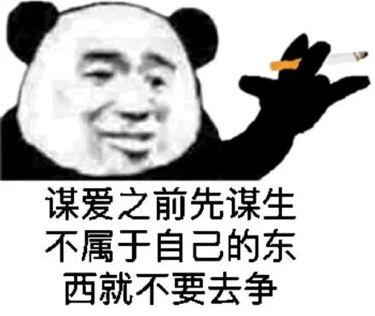
only+状语部分倒装
I make a living only by teaching.
Only by teaching do I make a living.

Slide 30
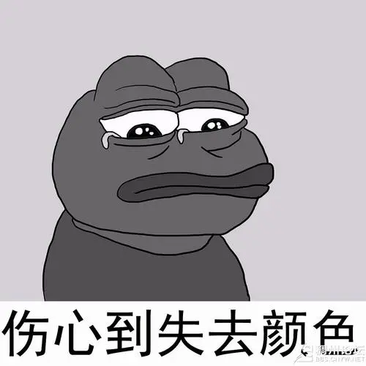
only+状语部分倒装
主倒从不倒！
I began to play the piano only after my father came back.
Only after my father came back did I begin to play the piano.

Slide 31
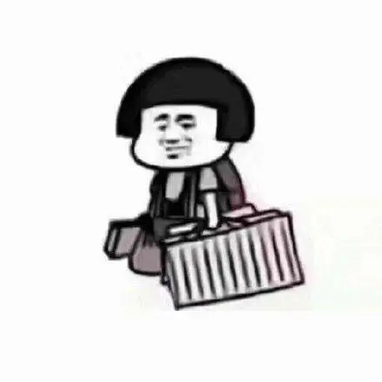
only+状语部分倒装
主倒从不倒！
He knew the news only when he returned his home.
Only when he returned his home did he know the news.

Slide 32
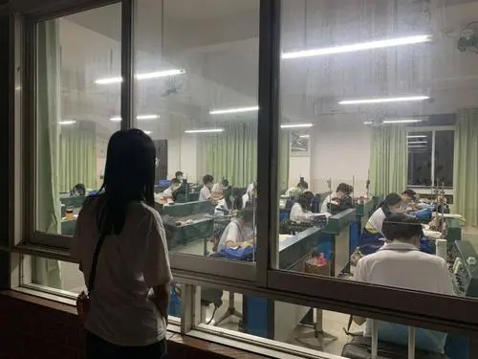
only+状语部分倒装
主倒从不倒！
The students stopped walking around only when the teacher came in .
Only when the teacher came in did the students stop walking around.

Slide 33

only+状语部分倒装
only修饰主语时不需要倒装
Only he can answer the question.

Slide 34
You will find it easier to work out the problem only in this ways.
Peter can have dinner only when his mother comes back.
We get such useful information only through the Internet.

Slide 35
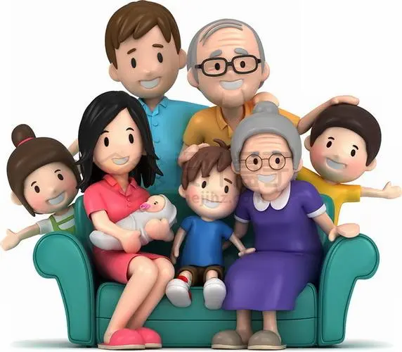
not until 部分倒装
not until遵循主倒从不倒
He did not realize the importance of family until he went through hard time.

Slide 36
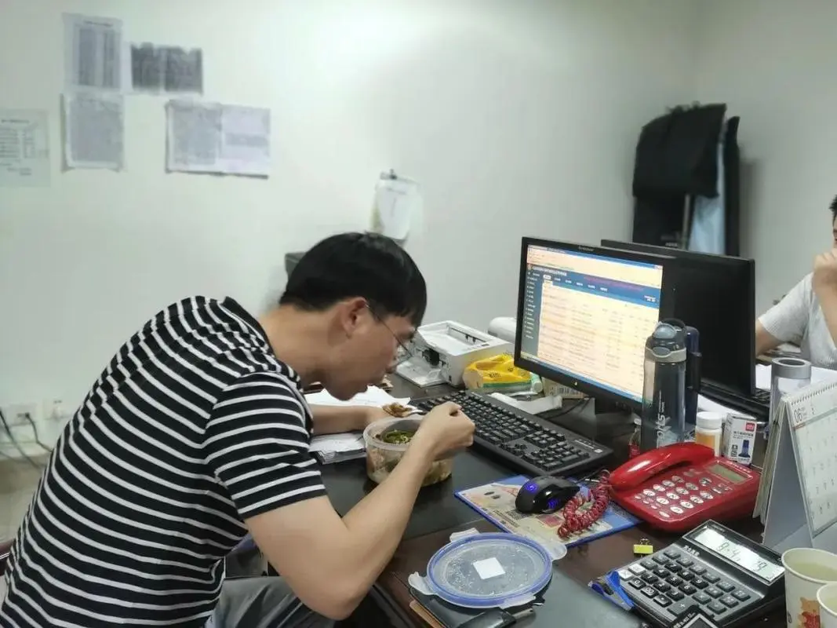
not until 部分倒装
not until遵循主倒从不倒
He did not leave until his boss arrived.

Slide 37
The girl did not come back until her mother called her.
Sally did not cry until her friends told this bad news to her.

Slide 38
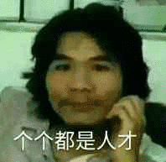
not only..but also 部分倒装
not only...but also遵循前倒后不倒
He can not only repair the broken bike, but he can also fix up my house.

Slide 39

not only..but also 部分倒装
not only...but also遵循前倒后不倒
The man will not only help her with housework, but he will also take good care of her.

Slide 40
He was not only a successful writer but he was also a wonderful composer.
She was not only intelligent but she is also very musical.

Slide 41
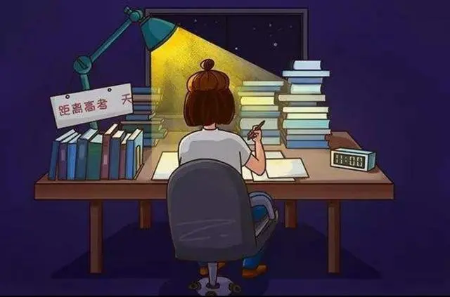
as, though 部分倒装
as, though倒装时，把表语和状语提前即可。
As/Though it was late, he still stayed up late studying at night.

Slide 42
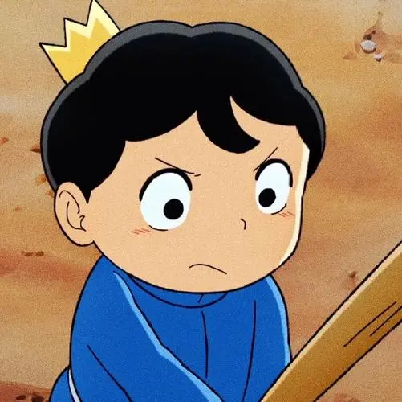
as, though 部分倒装
as, though倒装时，把从句中的表语和状语提前即可。
Though he is a king, he is not happy.

Slide 43
As he was tired, he went to bed early.
Though he is successful , he is not proud
Though he tried hard, he failed at last.

